Slide 1
FINC 616 Investment Management
Course Introduction
Semester 1 - 2025

Slide 2


Examiner and Lecturer
––––––––––––––––––––––––––––––––––
Dr Linh Ho
Senior Lecturer in Finance
Examiner - Investment Management
––––––––––––––––––––––––––––––––––
Faculty of Agribusiness and Commerce R222, 2nd Floor, Ross Building
Linh.Ho@lincoln.ac.nz
www.lincoln.ac.nz
––––––––––––––––––––––––––––––––––
Lincoln University
Te Whare Wānaka o Aoraki
––––––––––––––––––––––––––––––––––

Slide 3
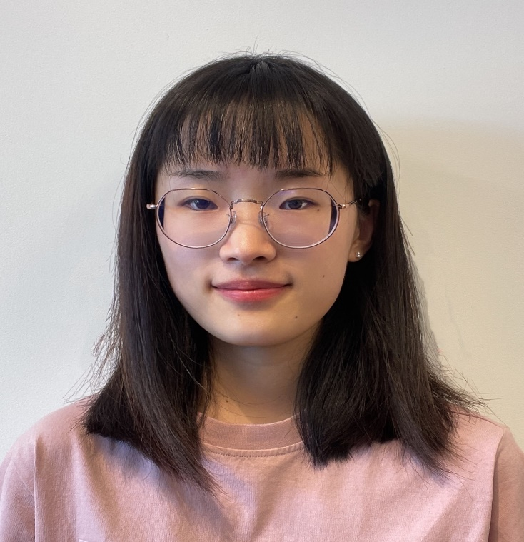
Teaching Assistant
––––––––––––––––––––––––––––––––––
Ms Amber Jin
Teaching Assistant
––––––––––––––––––––––––––––––––––
Faculty of Agribusiness and Commerce Shan.Jin@lincolnuni.ac.nz
www.lincoln.ac.nz
––––––––––––––––––––––––––––––––––
Lincoln University
Te Whare Wānaka o Aoraki
––––––––––––––––––––––––––––––––––

Slide 4
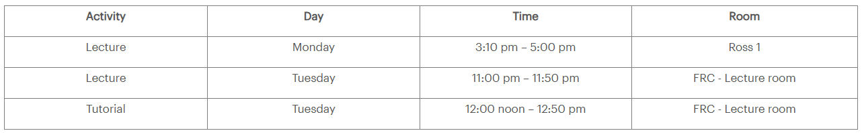
Course Outline
Available on the course LEARN page
Office hour | Tuesday | 1:00 – 2:00 pm | R222
At other times, appointments are welcome and recommended.
Linh Ho: Linh.Ho@lincoln.ac.nz
Face-to-face activities and office hours will be held on field trip days

Slide 5
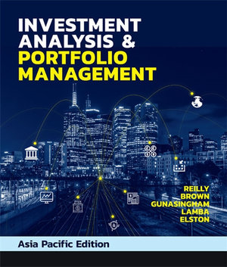
Resources
Required textbook:
Reilly, F. C., Brown, K. C., Gunasingham, B., Lamba, A., and Elston, F. (2020). Investment Analysis and Portfolio Management (Asia-Pacific Edition 1st ed.), Cengage. ISBN-13: 9780170416030
Link to purchase the textbook online:
https://nz.cengage.com/c/investment-analysis--portfolio-management-1e-gunasingham/lamba/elston/reilly/brown/9780170416030/?searchIsbn=978017
Use discount code WOW10 to receive 10% off at checkout.
The textbook has a comprehensive package of online resources.
A hard copy of the textbook is available from the bookshop.

Slide 6
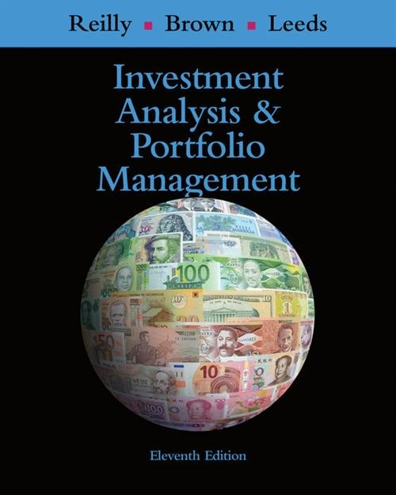
Resources
Students can use the alternative textbook below:
Reilly, F. C., Brown, K. C., and Leeds, S. J. (2019). Investment Analysis and Portfolio Management (11th ed.), Cengage. ISBN-13: 978-1-305-26299-7
An eBook is available on http://www.cengagebrain.co.nz/shop/isbn/9780357691489

Slide 7
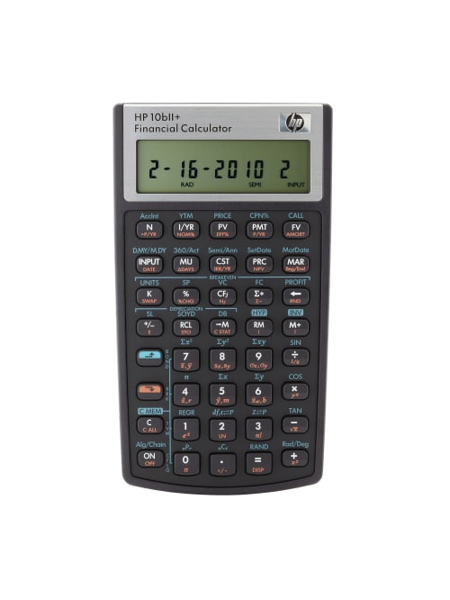
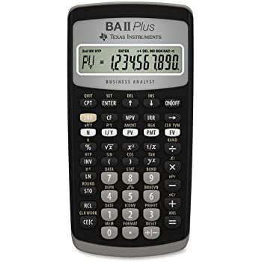

Equipment to purchase
A financial calculator:
Hewlett Packard (HP) 10BII+ or
Texas Instruments BA II Plus
Students who are considering writing the CFA exams may prefer the Texas Instruments BA II Plus because it is one of the calculators that is acceptable for CFA® exams.

Slide 8
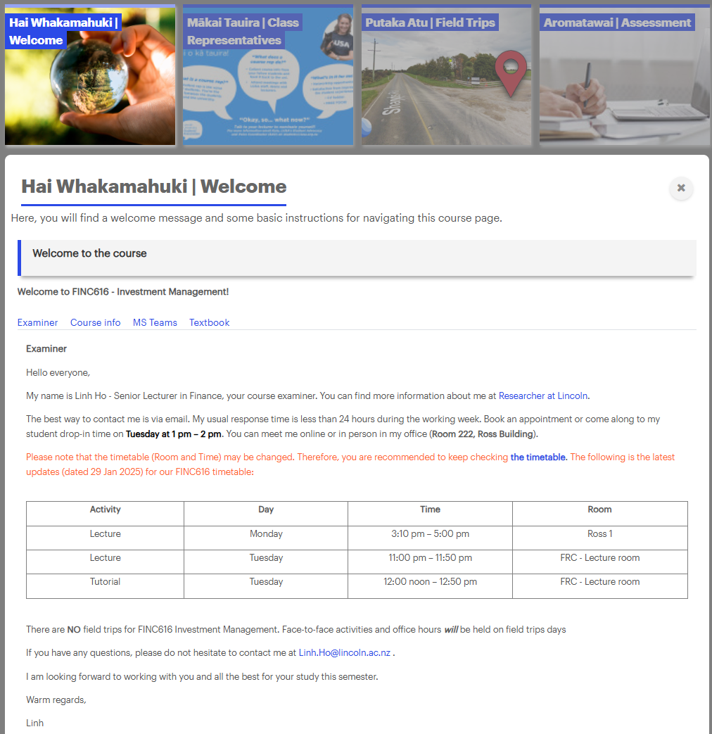
LEARN
Tabs

Slide 9
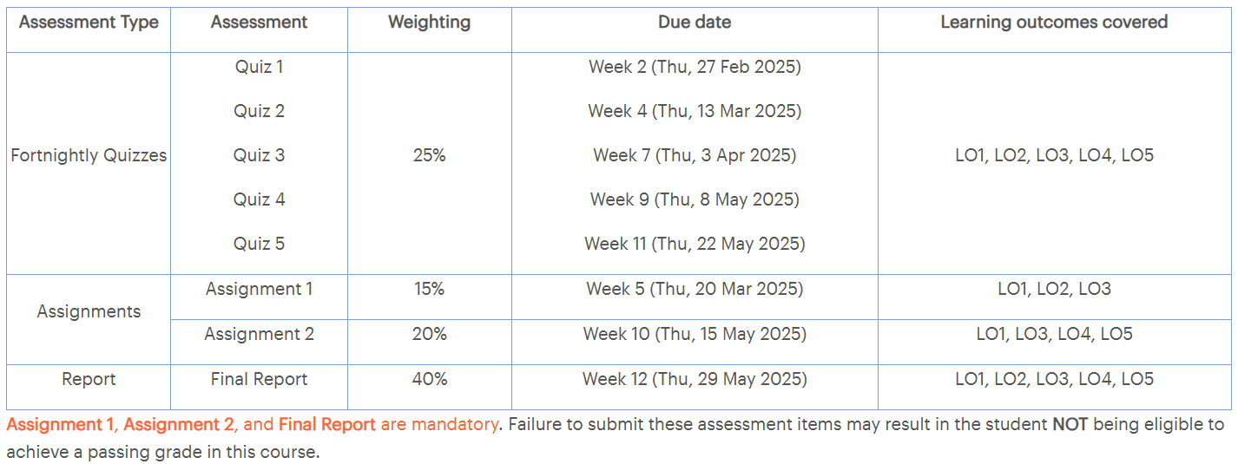
Individual Assessments - Online
PASS = at least 40% Final Exam + at least 50% Course Overall
Late submission? 1 day late: 10% points deducted
2 days late: 20% points deducted
3 days late: 30% points deducted
4 days late: 40% points deducted
5 days late: 50% points deducted
>5 days late: zero mark for the assignment

Slide 10
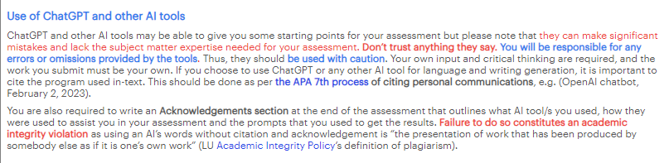

Policies and Procedures
What is expected of you in terms of your academic work:
Academic Integrity
Proctor Schedule of Penalties

Slide 11

We hope you enjoy your study this semester
Questions?
Contact Us @
https://www.lincoln.ac.nz/Contact-Us/

Slide 12

Notes:
Thank you for your attention.

